Slide 1
Intro to Logic Analyzers
hamster
SAINTCON25

Slide 2


Howdy
I’m hamster

Slide 3
01
BACKGROUND

Slide 4
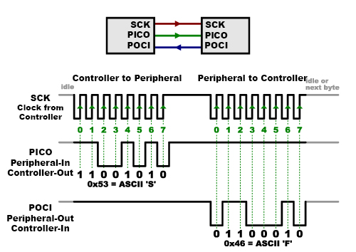
What is logic?
Logic is digital data – ones and zeros
Logic defines timing of pulses

Slide 5
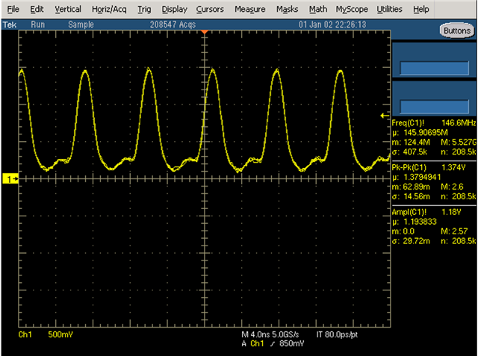
What is not logic?
Logic does not define voltage levels
Logic does not show rise and fall times

Slide 6
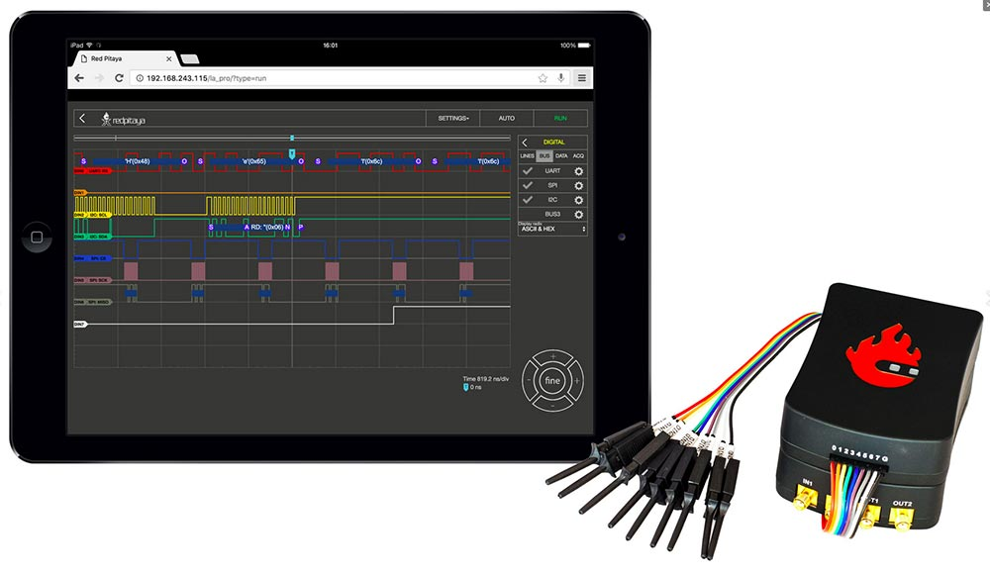
What is a logic analyzer?
A logic analyzer is a device that captures logic data
Logic analyzer software can usually also decode the raw data into ‘human’ readable bytes

Slide 7
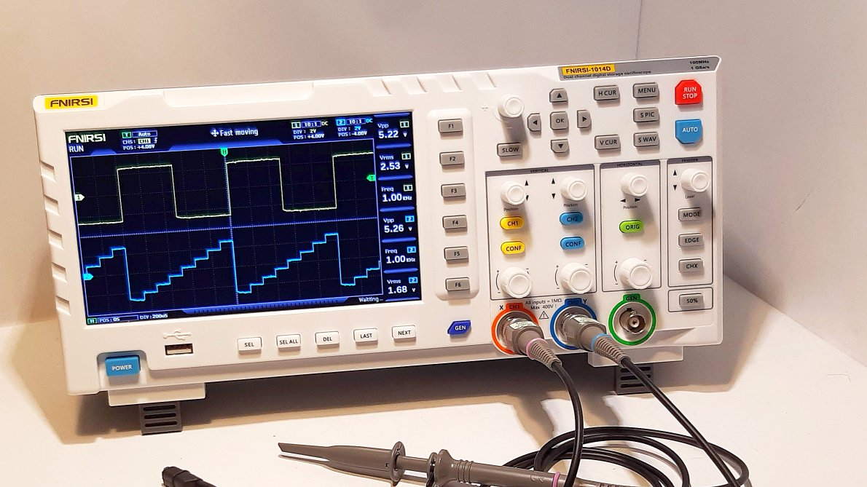
What about an oscilloscope?
An oscilloscope displays voltage with respect to time
An oscilloscope will likely not decode the data
Some oscilloscopes have built-in logic analyzers

Slide 8
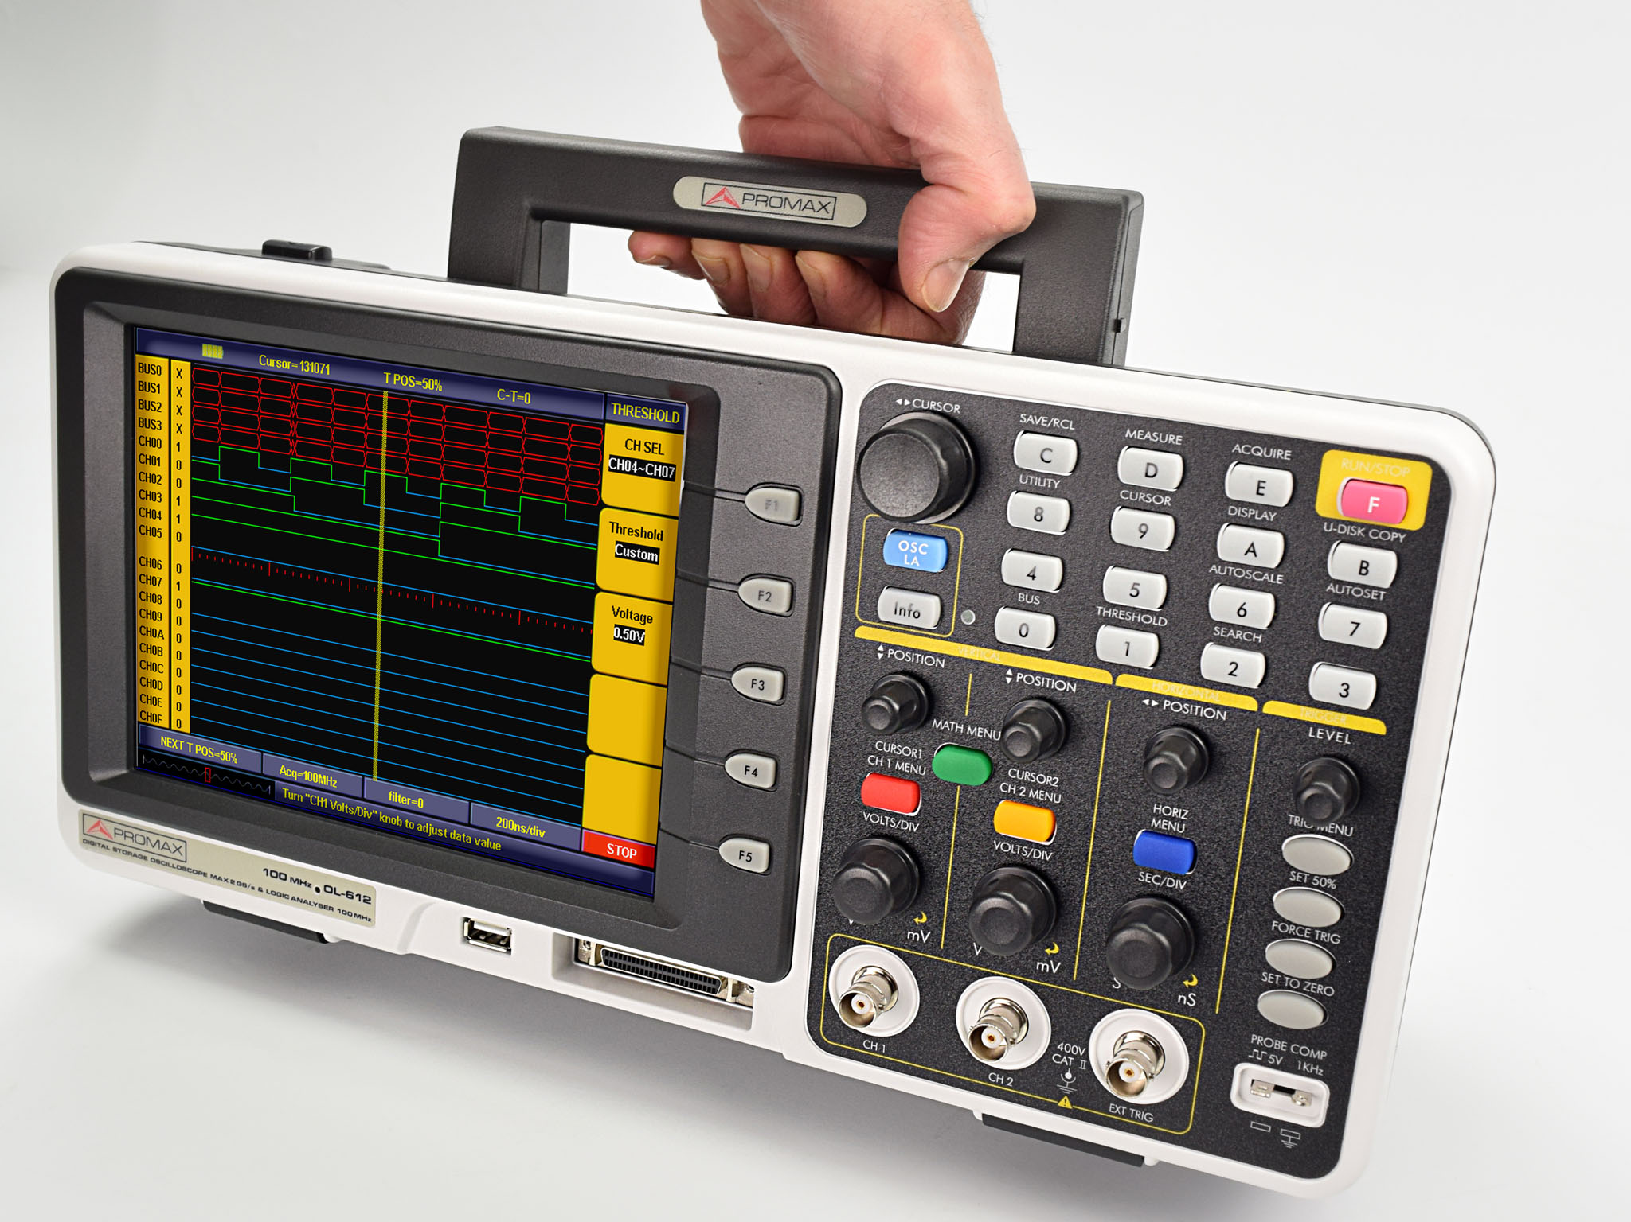
What one to choose?
Oscilloscope
- Shows what is actually on the wire
- Can see rise and fall times, voltage levels, and noise
- Pick a scope when you need low level troubleshooting

Slide 9
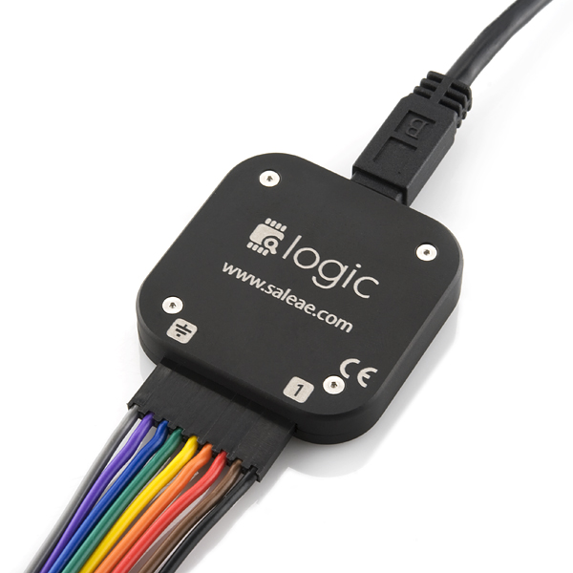
What one to choose?
Logic Analyzer
- Shows a representation of data
- Can decode data streams
- Pick this when you need to decode/debug a data stream

Slide 10
02
PICKING A LOGIC ANALYZER

Slide 11
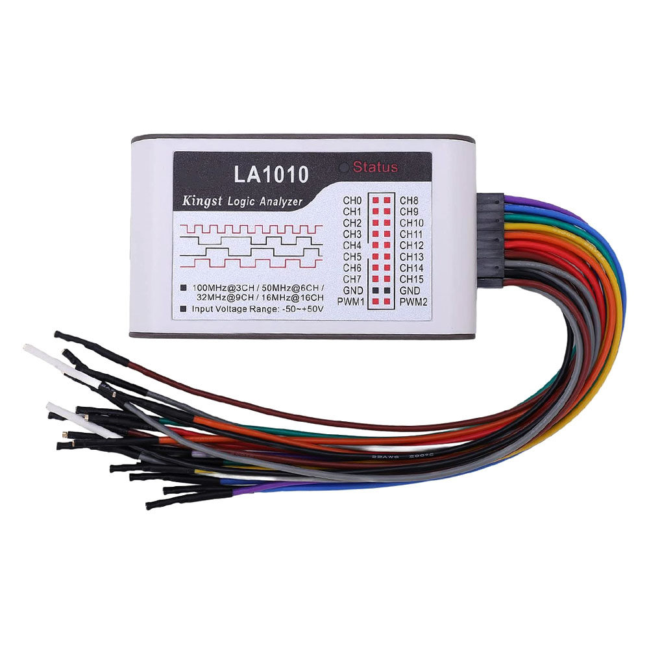
What are the features?
Channels
Speed
Buffer
Software
Cost

Slide 12
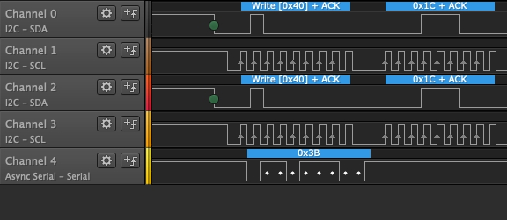
Channels
Channels are captured in parallel to compare multiple signals
Multiple channels are needed for some protocols
I2C – 2 channel
SPI – 3+ channels
Parallel – 8+ channels

Slide 13
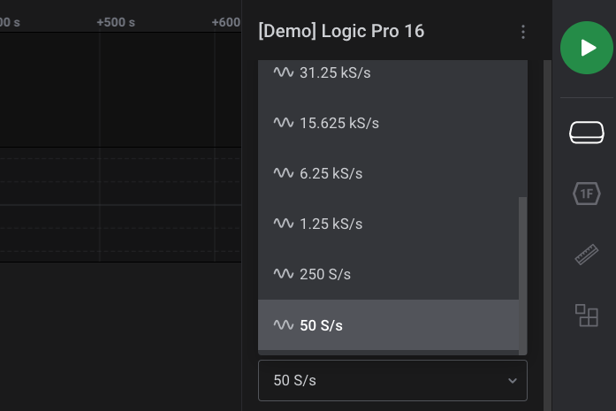
Speed
Sample rate is important to capture all the data
Nyquist-Shannon sampling theorem states that the sample rate must be at least twice the captured signal in order to avoid aliasing
Aliasing basically means you miss edges because they happen while you are not looking

Slide 14
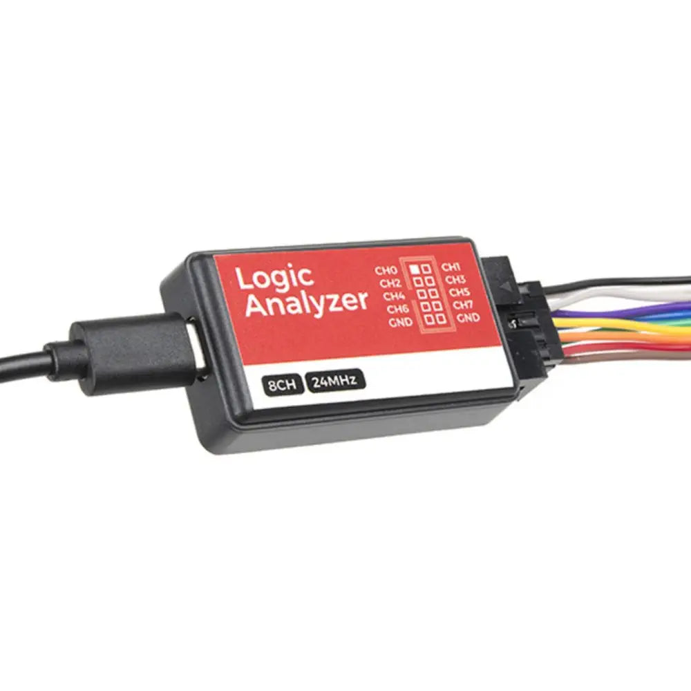
Buffer
Buffers store data on the analyzer in real-time so they can be streamed later to a PC
Larger buffers allow more sampling time before needing to ‘come up for air’ and transfer the data back to the host

Slide 15
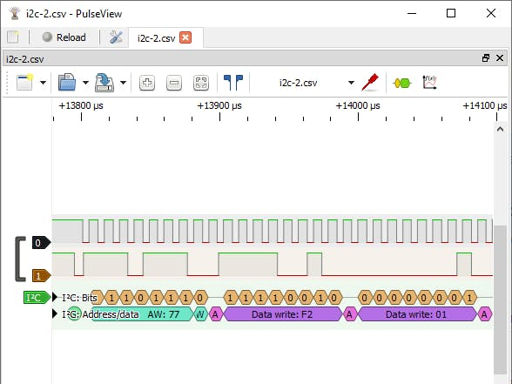
Software
Some open-source software such as PulseView or sigrok exist and supports most logic analyzers
Vendor software is a grab bag of awful and awesome

Slide 16
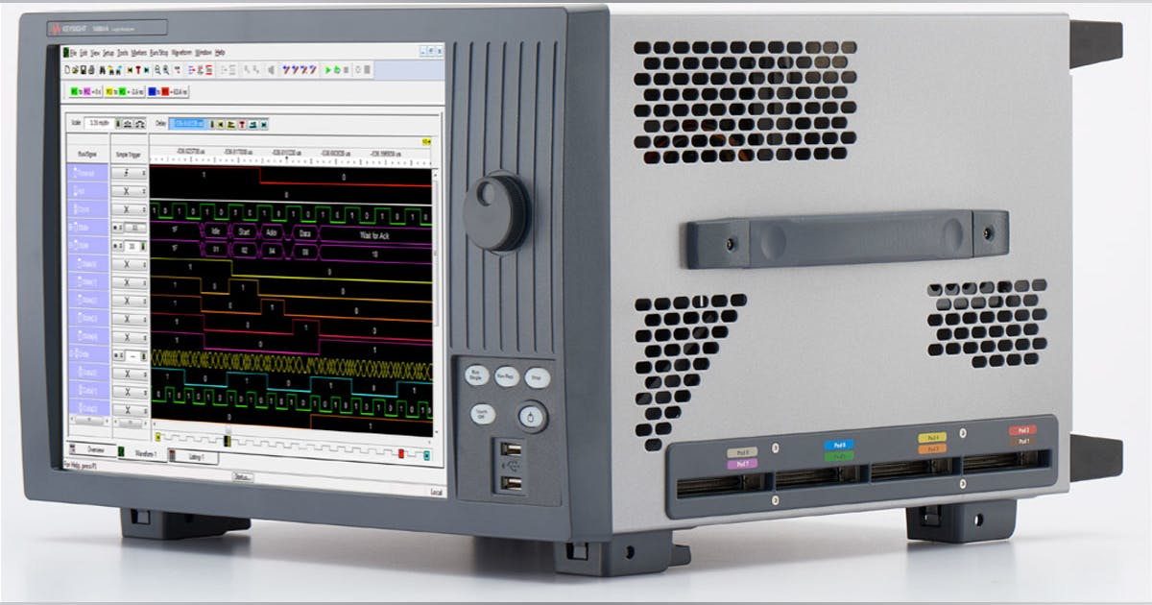
Cost
Standalone models can be very expensive
Better features add cost
Very cheap logic analyzers work for most casual users, however

Slide 17
03
CHEAP LOGIC ANALYZERS

Slide 18
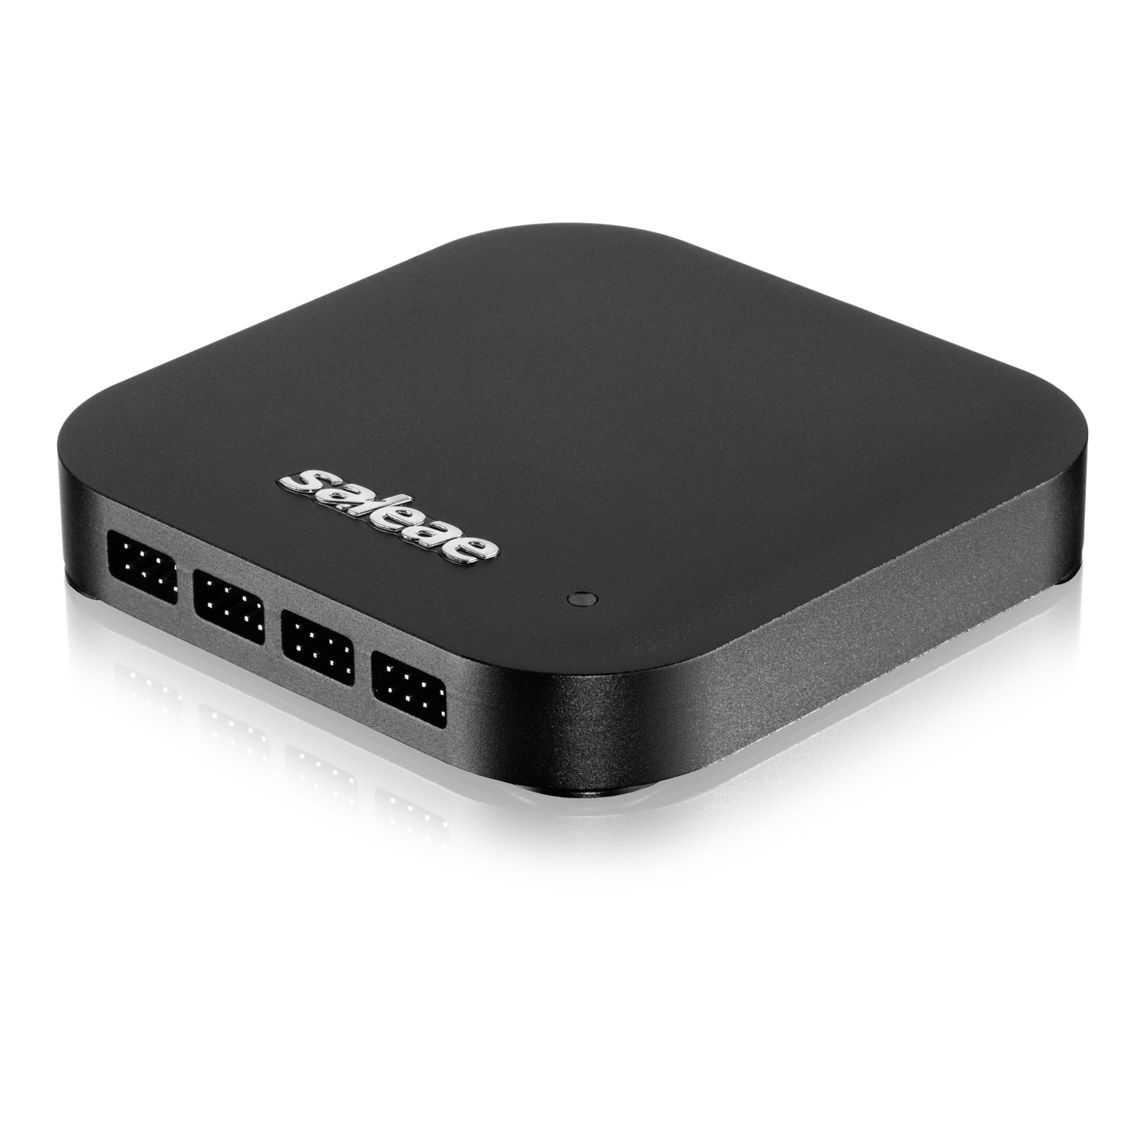
Logic Analyzers on the Cheap
Saleae logic analyzers cost between $500-$1500
Some models have oscilloscope channels as well
Very good ‘cheap’ units
Software is very good
Very often older models are cloned

Slide 19
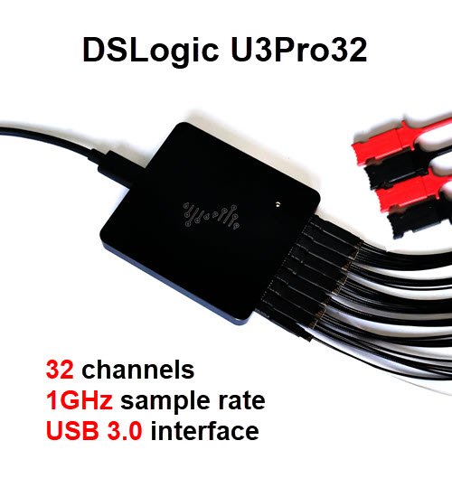
Logic Analyzers on the Cheap
DreamSourceLab has models from $150-$400
Software is a closed source spin of PulseView (more or less)
A very good value for hobbyists who want something professional

Slide 20
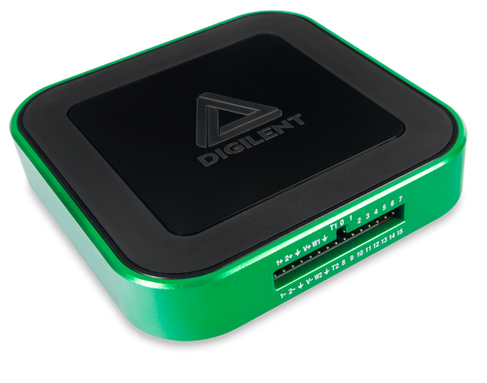
Logic Analyzers on the Cheap
Digilent Analog Discovery is about $380
Bonus with this unit is that it has a couple of oscilloscope channels as well
Software works pretty well

Slide 21
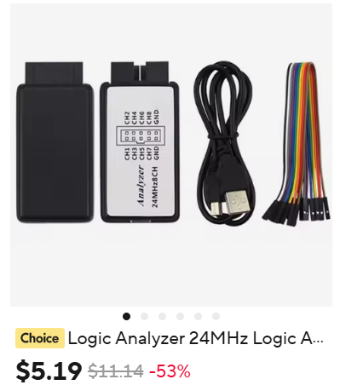
Logic Analyzers on the Cheap
Chinese clones are $3-8 bucks depending on tariffs
Most clone Saleae Logic 8 analyzers and will work with Saleae software
Pretty reasonable for a pocket logic analyzer

Slide 22
04
SETTING UP

Slide 23
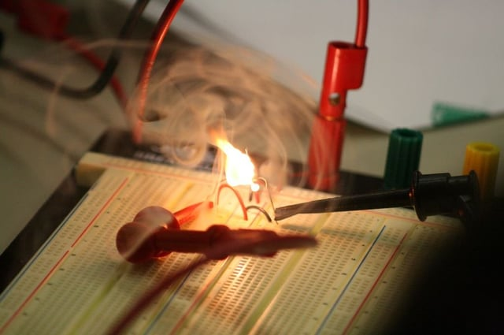
Circuit considerations
Make sure you know your voltage levels of the signal you want to connect to
Be careful you are not providing a ground path from an isolated, high voltage system through your computer
Any probe on a live circuit can affect how the circuit works or cause it to glitch or stop working

Slide 24
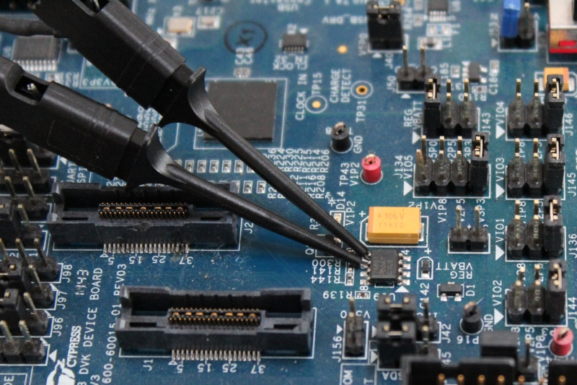
Connecting
Probe clips are usually used
Connect with the device power off to prevent shorts
Make sure you always connect up a ground

Slide 25
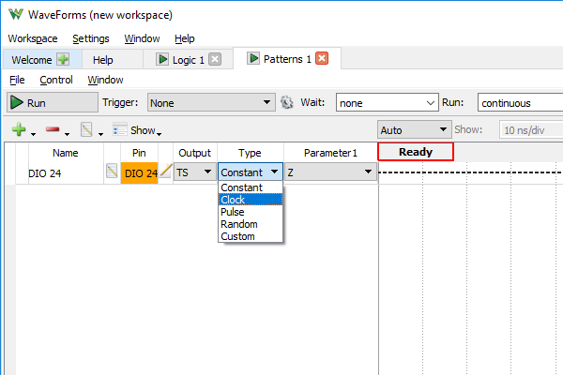
Setting up
Configure each channel type
You can rename channels

Slide 26
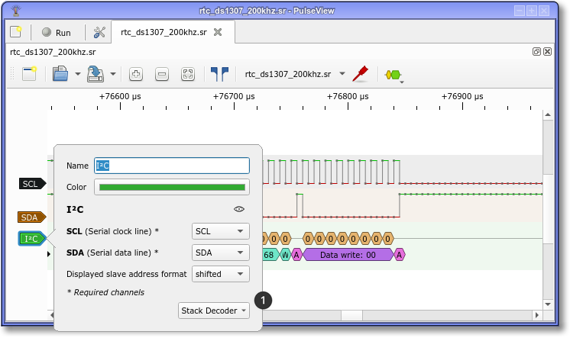
Protocols
To decode a protocol, depending on the software, you add a decoder and use a popup to select what channel is what pin

Slide 27
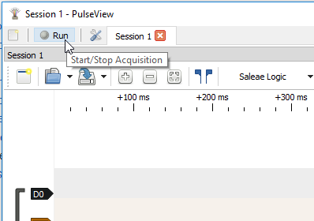
Triggering
Triggers can be set to start captures when a certain logical condition is met
Or you can just start a capture
Or you can run an auto-repeating capture

Slide 28
05
RESULTS

Slide 29
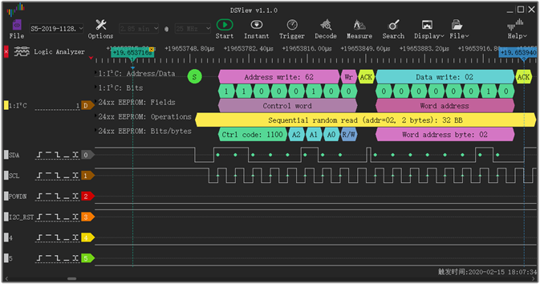
Example

Slide 30
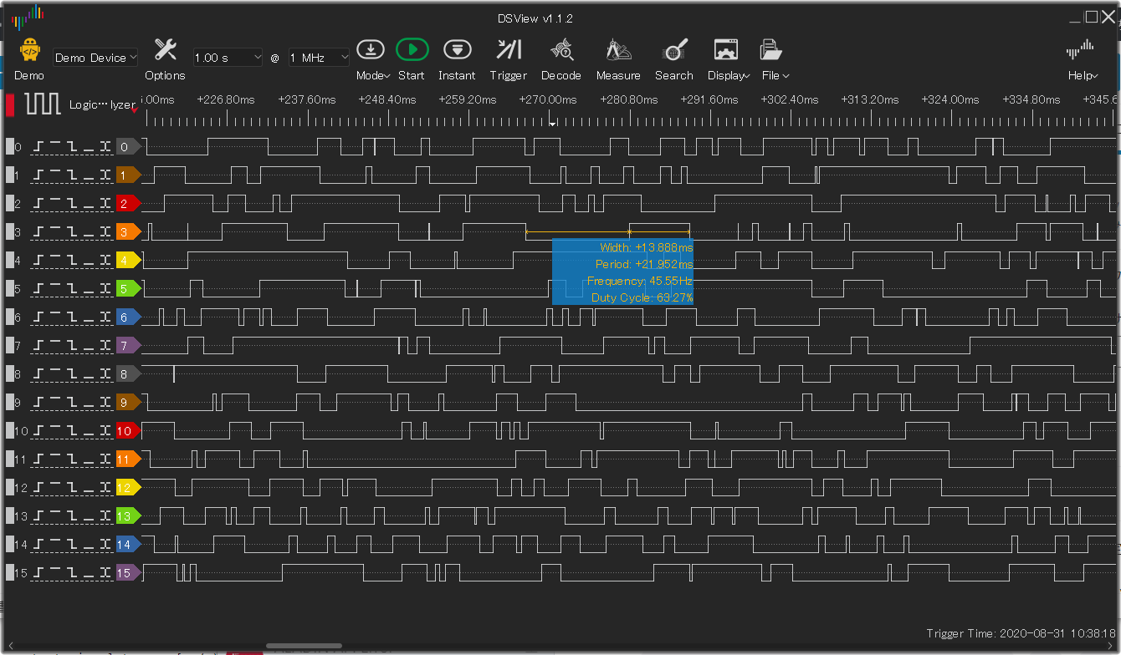
Example

Slide 31
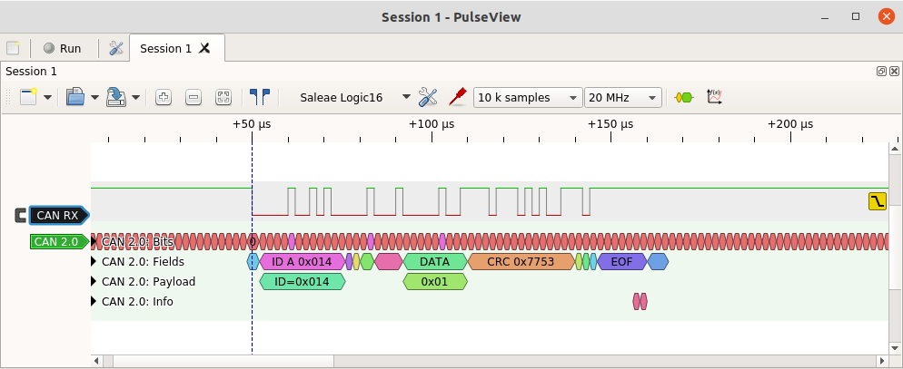
Example

Slide 32
THANKS!
Do you have any questions?
Mastodon @hamster@fosstodon.org
bsky @hamster.dczia.net
Twitter @hamster
Discord @pcbhamster
Srsly that’s too many

